Slide 1
Search Center

Slide 2
AWS Open Search - why Open Search?
Licence
Elastic changed Elasticsearch license to ELv2
AWS OpenSearch remains Apache 2.0
Security and Privacy
Elasticsearch has advanced security as part of Elastic Cloud
AWS OpenSearch has OOTB integration with AWS identity services
Integration with other AWS services (S3, Lambda, DynamoDB)

Slide 3
AWS OpenSearch benefits
Operations: similar to relational data storages (RDS)
Security: Cognito, IAM, VPC, KMS, SSL
Reliability: Multi-AZ, clustering
Performance: petabyte scale
Cost: pay per node provisioned (similar to RDS)

Slide 4
AWS OpenSearch sideeffects
Small community / limited use cases
Crude manuals and documentation
Further deviation in functionality relative to Elasticsearch

Slide 5
AWS OpenSearch Service access policies
Resource-based
Identity-based
IP-based
Fine-grained access control

Slide 6
Fine-grained access control benefits
Role-based access control
Security at the index, document, and field level
OpenSearch Dashboards multi-tenancy
HTTP basic authentication for OpenSearch and OpenSearch Dashboards

Slide 7
Permissions trimming challenge
Need for support of Users / User Groups / Business Units / Roles combinations
Dynamic app policies with custom cases
Performance limitations of indexes update possibilities
OOTB permission models doesn’t feet system needs

Slide 8
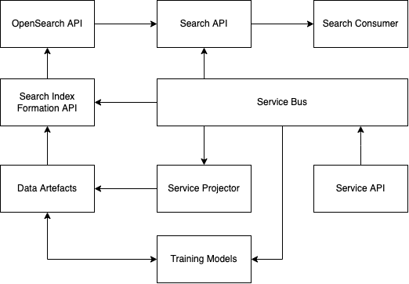
Proposed solution

